Slide 1
Types of NoSQL Databases
Module -2

Slide 2
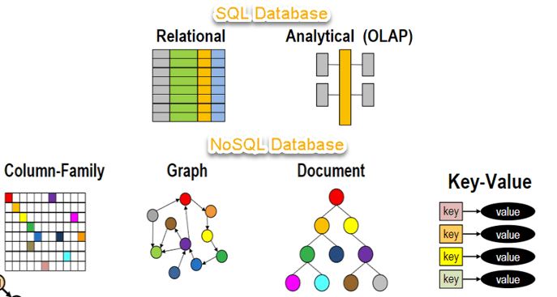
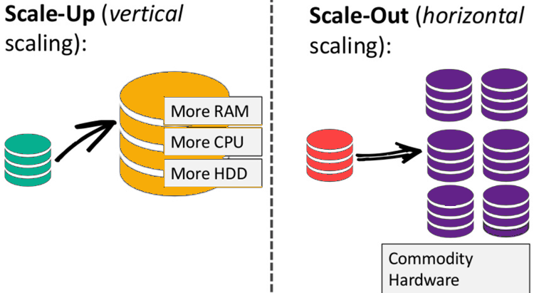
NoSQL Database
What is NoSQl ?
Difference between SQL & NoSQL
Alternate system for traditional DB
Non relational database
Flexible Schema
Scalability

Slide 3
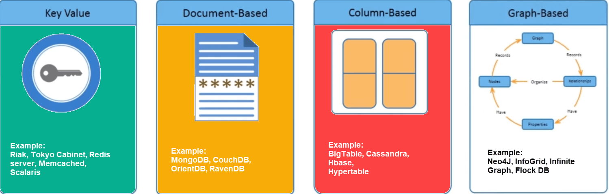
NoSQL Database Categories
Key – Value Pair
Column-Oriented
Graph Based
Document-Oriented

Slide 4
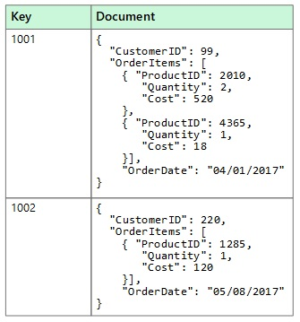
1. Document Database
Store data as JSON, BSON ox XML documents
Documents can be stored and retrieved in a from closer to data objects
Used for CMS system, blogging platforms, real time analytics and ecommerce applications
Eg: MongoDB, Amazon simple DB, Lotus notes, Couch DB

Slide 5
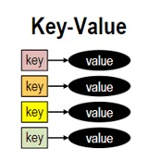
2. Key – Value Store
Simplest form of NoSQL DB
Handle lots of data and heavy loads
Data is Stored in Key-Value pair
attribute name and value
Eg: Redis, Dynamo, Riak

Slide 6
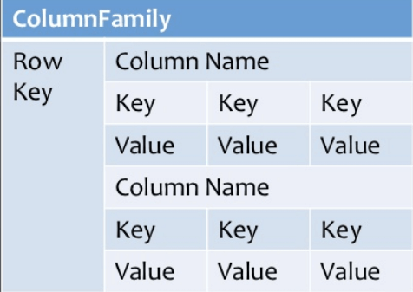
3. Column Oriented DB
A column store is organized as a set of columns
Efficient compression and reads faster
Aggregate operations can be performed faster
Widely used to manage data warehouse, business intelligence, CRM , Library card catalogs.
Eg: Hbase, Cassandra, Hypertable

Slide 7
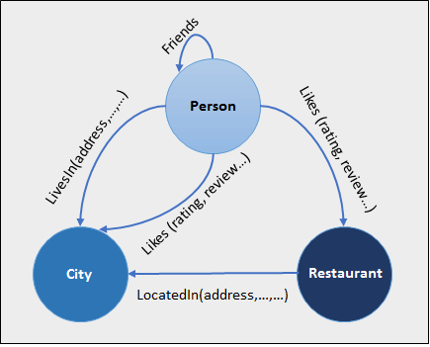
4. Graph Database
Focus on relationship between elements
Each element is stored as a node
Connection between elements are called link or relationship
Connections are the first class elements
Use cases – fraud detection, social network and knowledge graph
Used mainly for social networks, logistics, special data
Eg: Neo4J, FlockDB, Infinite Graph, orientDB

